Slide 1


FIT9136 PASS WEEK 11
Introduction to Divide & Conquer
14th Oct 2024
CL_33 Innovation Walk, Room C107 / Online

Slide 2

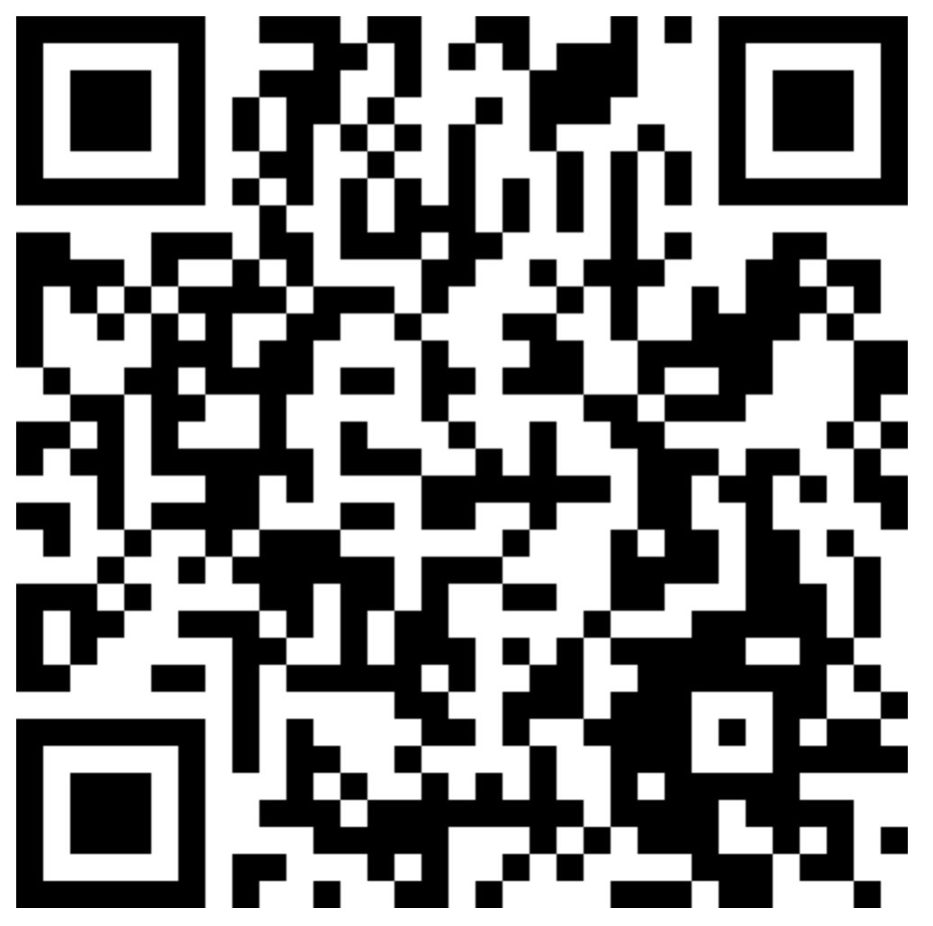
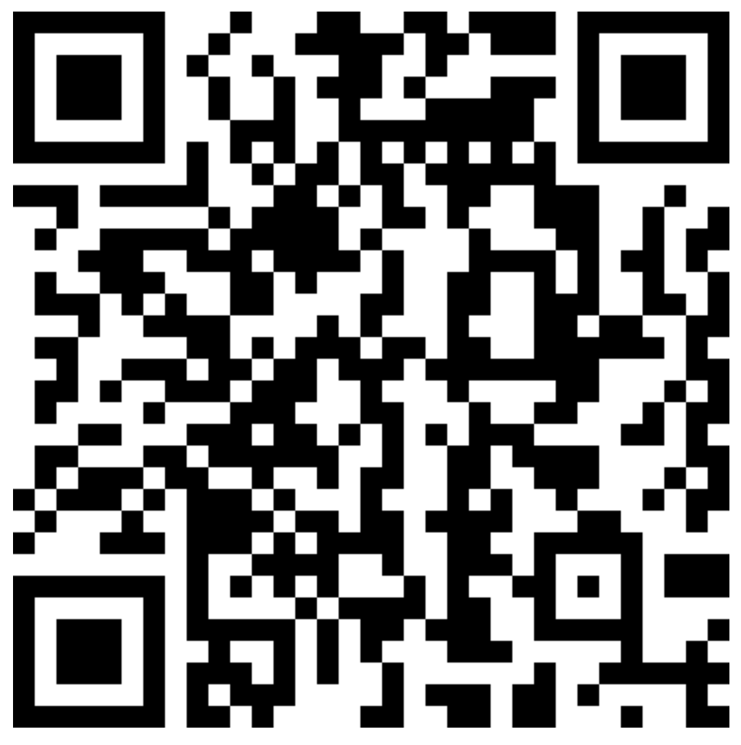
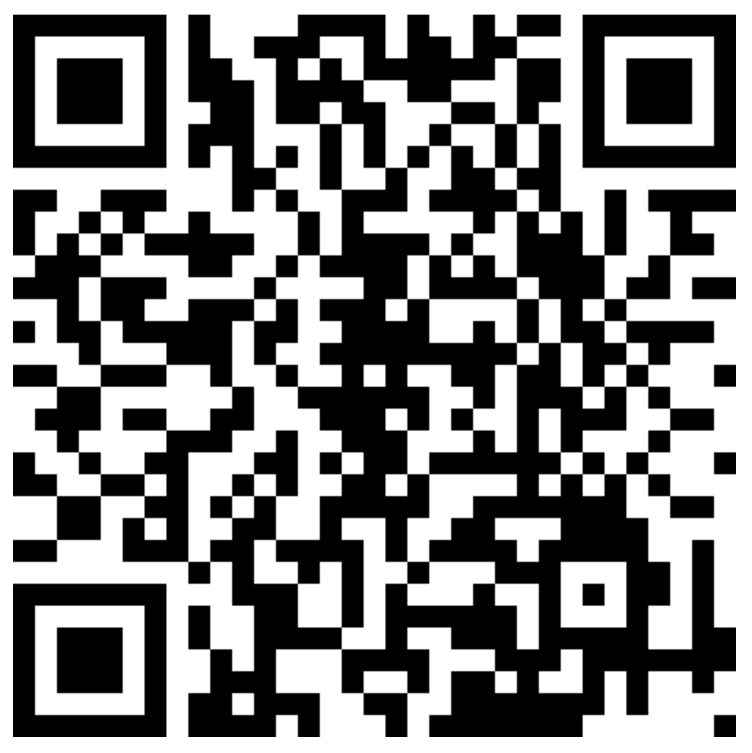

Attendance & Resources
Any questions? Email me: harry.wang1@monash.edu
Also find the drive to receive the weekly slides: https://tinyurl.com/FIT9136-PASS
Want to have GitHub Repo to access them? GitHub: https://github.com/chiefhaowang/PASS-Weekly
SSH: git@github.com:chiefhaowang/PASS-Weekly.git
HTTPS: https://github.com/chiefhaowang/PASS-Weekly.git
Monday 2-3pm
Tuesday 9-10am
Tuesday 4-5pm

Slide 3
Agenda
01
Merge Sort & Quick Sort - 15 mins
Concept recap
02
Unit Conclusion - 30 mins
03
Closure speaking - 10 mins
Conclusion + Q&A + Attendance recording

Slide 4
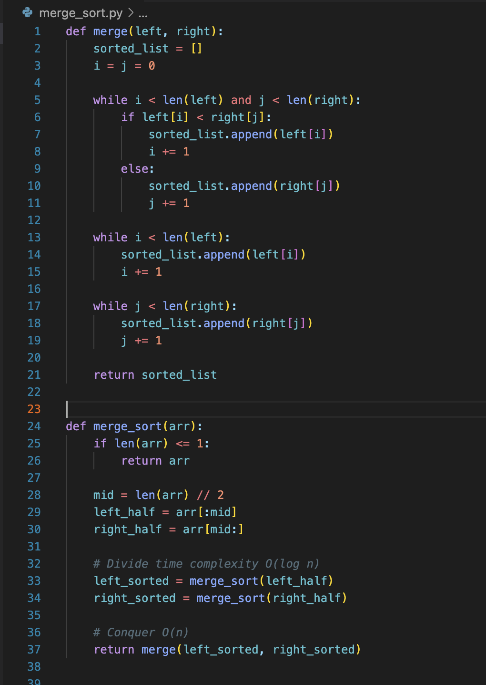
Merge Sort
Sorting Method:
Spilt the original list
Sort the original list from sorting the splitted list
Tips:
Time Complexity: O(n * log n)

Slide 5
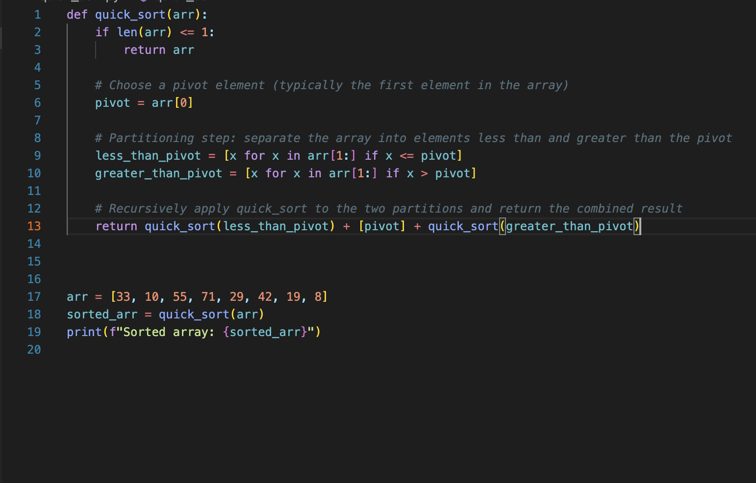
Quick Sort
Time Complexity:
Best & Average: O(n* log n)
Worst: O(n^2)

Slide 6

Let’s look back
Basic Python Syntax: week 1 - 6
Variables, Expressions,Code Statements
Basic data structure: list, string
Scope
If / else
Loop: for / while
Conditions
Functions
More data structures: dictionary, set
OOP: Object Oriented Programming
PP: Procedural Programming

Slide 7

Let’s look back
Introducing main programming features:
File I/O
Python Modules and Library (Python community)
Searching & Sorting
Time Complexity
Divide & Conquer

Slide 8
A little advice before your real learning journey
Python is not only just Programming Language
Python is …
The way to talk with developers (BIS)
The way to analyse data (DS)
The way to build model (AI)
The way to develop software (IT & CS)

Slide 9
A little advice before your real learning journey
Research
Good for students willing to extend academic journey
Meet Professors and outstanding students, start building your own network at Monash
Access job opportunities at Monash, eg. Teaching Associate
May start your own research
Industry Experience
Good opportunity for BA students to do business analytics and try managing project
Work with students in other disciplines, gain insights of how to collaborate
Build an IT project and get experience of software development
Learn how the working environment in Australia is

Slide 10
Welcome to Monash!
Good Luck!

Slide 11
Thank you !
14th Oct 2024
CL_33 Innovation Walk, Room C107 / Online

Slide 12
Attendance & Resources
Any questions? Email me: harry.wang1@monash.edu
Also find the drive to receive the weekly slides: https://tinyurl.com/FIT9136-PASS
Want to have GitHub Repo to access them? GitHub: https://github.com/chiefhaowang/PASS-Weekly
SSH: git@github.com:chiefhaowang/PASS-Weekly.git
HTTPS: https://github.com/chiefhaowang/PASS-Weekly.git
Monday 2-3pm
Tuesday 9-10am
Tuesday 4-5pm

Slide 13
Questions & Answers
14th Oct 2024
CL_33 Innovation Walk, Room C107 / Online

